Slide 1
Jefferson High School

Slide 2
Agenda
Welcome
Cambridge AICE Benefits
Cambridge AICE Diploma
Exam Information
Questions

Slide 3
Advanced
International
Certificate of
Education

Slide 5
Learner Attributes Cambridge Learners are…
Confident
Secure in Knowledge
Comfortable Exploring & Evaluating Ideas and Arguments
Responsible
Takes Ownership of Learning
Demonstrates Intellectual Integrity
Reflective
Values the Process of Learning as well as the Products
Develops Strategies to Become a Life-Long Learner
Communicate & Defend Views and Opinions While Respecting Others
Collaborative & Supportive
Appreciates Culture, Context, and Community
Innovative
Resourceful, Creative, and Imaginative
Engaged
Curious and Inquiry Driven
Applies Knowledge and Understanding to New Situations
Receptive to New Ideas
Equipped to Participate Constructively in Society and the Economy (Locally, Nationally, and Globally)
Intellectual Risk Takers
Equipped for New and Future Challenges

Slide 6
Benefits of Taking AICE Courses
Earn college credit
Greater Flexibility
AICE Program graduates had a higher GPA (3.46) whereas students coming from other acceleration mechanisms such as Advanced Placement (AP) and International Baccalaureate (IB) had an average GPA of 3.12 and 3.10 respectively.
Bright Futures Eligibility

Slide 7
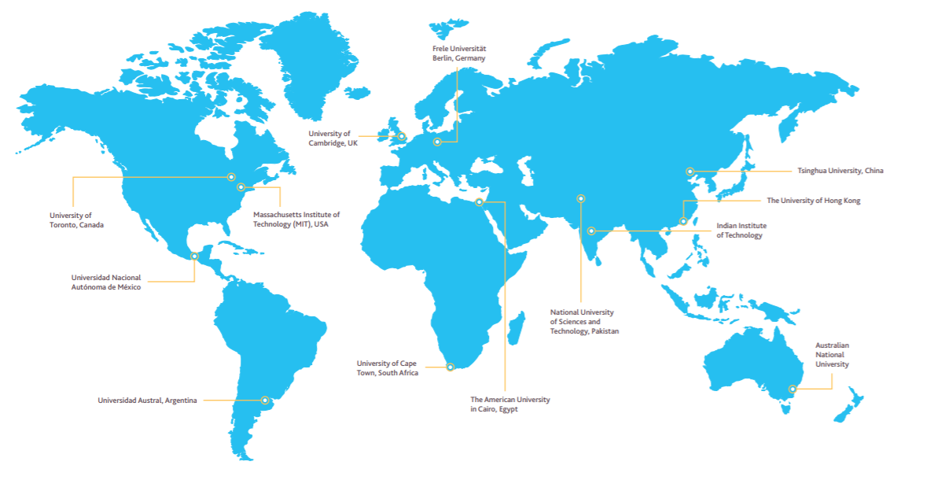
International recognition
Cambridge qualifications are accepted at over 1400 institutions across 195 countries, including top ranking universities around the world.
Notes:
Cambridge qualifications are accepted at over 1400 institutions across 195 countries, including the top ranking universities around the world that you can see on this slide.
Cambridge students can be confident that their qualifications will be understood and valued throughout their education and career, in their home country and internationally.
Students use Cambridge International AS & A Levels to gain places at leading universities worldwide including in the UK, Ireland, USA, Canada, Australia, New Zealand, India, Singapore, Egypt, Jordan, South Africa, the Netherlands, Germany and Spain.
Cambridge International AS & A Levels are accepted for entrance to all UK universities.
In places such as the United States and Canada, good grades in carefully chosen Cambridge International A Level subjects can result in up to one year of university course credit.
Over 650 US universities accept Cambridge International AS & A Levels, including all Ivy League and Ivy Plus universities. These universities include Brown, Harvard, MIT, Stanford and Yale.
For more information about recognition of Cambridge qualifications, including a database of institutions that accept them, go to www.cambridgeinternational.org/recognition where you will find a recognition database listing all the universities and higher education institutions that recognise Cambridge qualifications.
It is easy to search the database to find university entry criteria - you can search by country and by qualification.

Slide 8
HOW IS AICE GOING TO PREPARE STUDENTS FOR LIFE?

Slide 9
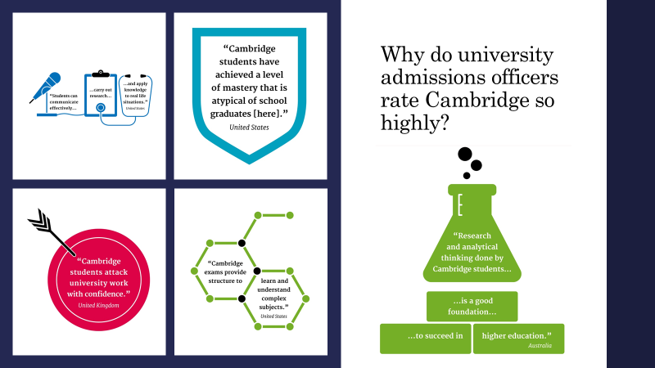

Slide 10
High school academics tend to focus on memorization, while college courses are geared more toward conceptualization.
College courses require more study time than high school students are used to – two to three hours per hour spent in class on average – and good writing skills, something that’s not as necessary in high school.

Slide 11
AICE courses are aligned with 21st Century Skills

Slide 13
AICE Diploma Option

Slide 14
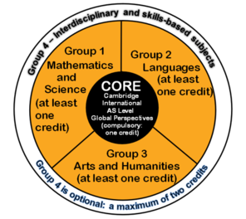
AICE DIPLOMA PLAN
Students need to earn a total of 7 credits by passing AICE exams in 25 months (3 exam cycles).
Students must take a course in each of the 3 groups
Every AICE diploma student must take AS Level Global Perspectives
Students may take more than the required 7 courses for the diploma

Slide 15
AICE Course Offerings
Group 1: Math & Science | Group 2: Languages | Group 3: Humanities | Group 4: Interdisciplinary
AS Level Marine Science | AS English Language AS Spanish Language | AS Level History, US AS Level Media Studies AS Accounting | AS English General Paper AS Thinking Skills
ALL AICE DIPLOMA SEEKING STUDENTS WILL TAKE AS LEVEL GLOBAL PERSPECTIVES

Slide 16
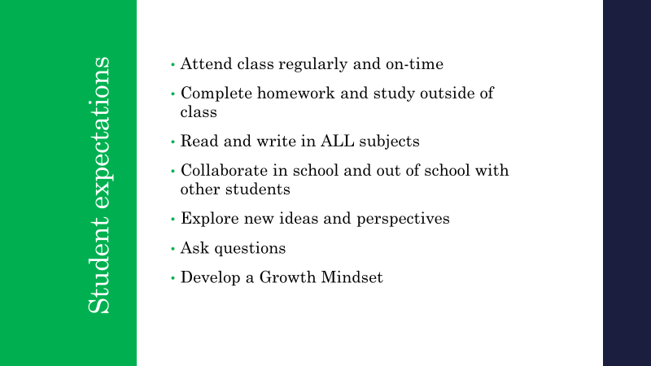

Slide 18
How to support your student:
Along with grades, connect with the teachers about your student's progress.
Ask your student about what they are learning, what is hard, what they like, etc. Have them show you!
Ask about deadlines and due dates: Most students struggle because they have a hard time managing time.
Listen: They will complain because authentic learning is hard.

